Slide 1

Week 2 – Mathematics for Cryptography I
CT5046 Cryptography and Security
University of Gloucestershire

Slide 2
Overview
Integer arithmetic
Integer division
Modular arithmetic
Matrices
Recap of lecture
Post-sessional work

Slide 3
Integer Arithmetic and Division

Slide 4
Overview
Refer to operations which are applied to a set of integers
In the context of cryptography, integers contain all numbers from minus infinity to plus infinity. When laid out in mathematical terms, it looks like this:
Z = {−∞, ..., −2, −1, 0, 1, 2, .., +∞}

Slide 5
Binary Operations
Binary operations in cryptography refer to operations that will:
Take as inputs two integers
Produce as output one integer
The three binary operations we engage in cryptography are:
Addition (+)
Subtraction (−)
Multiplication (×)

Slide 6
Integer Division
When dividing two integers a with b, we get two numbers namely:
Quotient q: The result of the division
Remainder r : The leftover from the operation
The relationship between a, b, q, and r can be written as:
a = q × b + r

Slide 7
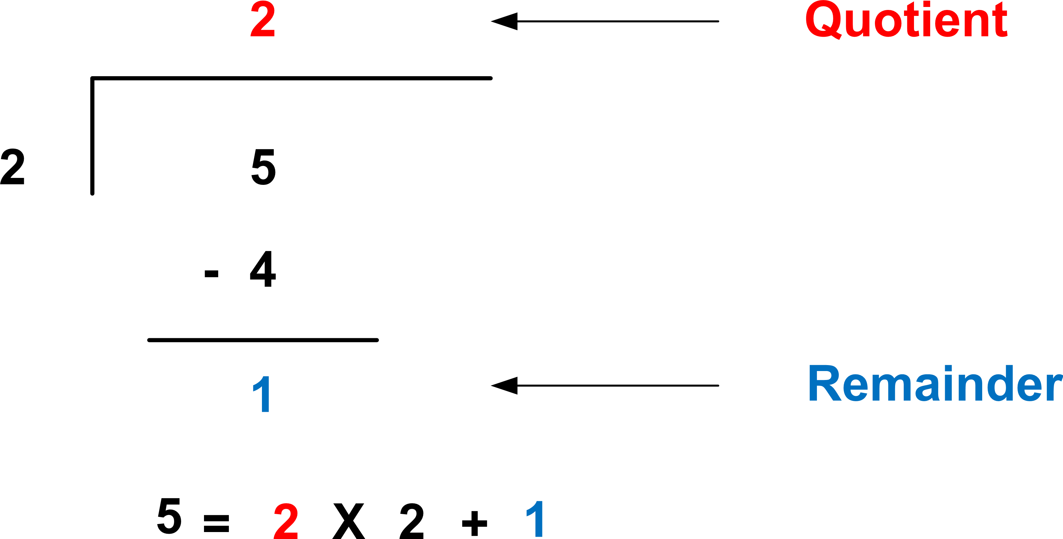
Division Overview

Slide 8
Divisibility
When we talk about divisibility, we are referring to cases where the remainder r is zero
To express this in an equation, it means:
a = q × b
If the remainder is zero, we write it like this: a | b
Otherwise, we write it like this: a ̸ |b

Slide 9
Modulo operator

Slide 10
Overview
So far, we have been looking at integer arithmetic, in which the result of a division operation can be express as:
a = q × b + r
In modular arithmetic, however, we are interested in one and only one of these 4 outputs: remainder r

Slide 11
Modulo operator
Denoted by mod
It is usually used like this where r , a, and b have the same meaning as before:
r = a mod b
For instance, is the following true?
1 = 10 mod 3

Slide 12
Exercise
What are the moduli of the following mod operations?
5 mod 26
21 mod 7
-18 mod 14
Question: What should we do if we get a negative modulo?

Slide 13
Handling negative values
Let’s look at this example: -20 mod 3
By default, the answer will be this: -2 = -20 mod 3, since:
a = q × b + r
−20 = −6 × 3 + (−2)
The solution here is to reduce q by 1 and add b to r . This then becomes:
−20 = −7 × 3 + 1

Slide 14
Matrices

Slide 15
Overview
A rectangular array of numbers
Organised in m rows and n columns
Each element within the matrix is referred to as: A = [a_{ij} ]

Slide 16
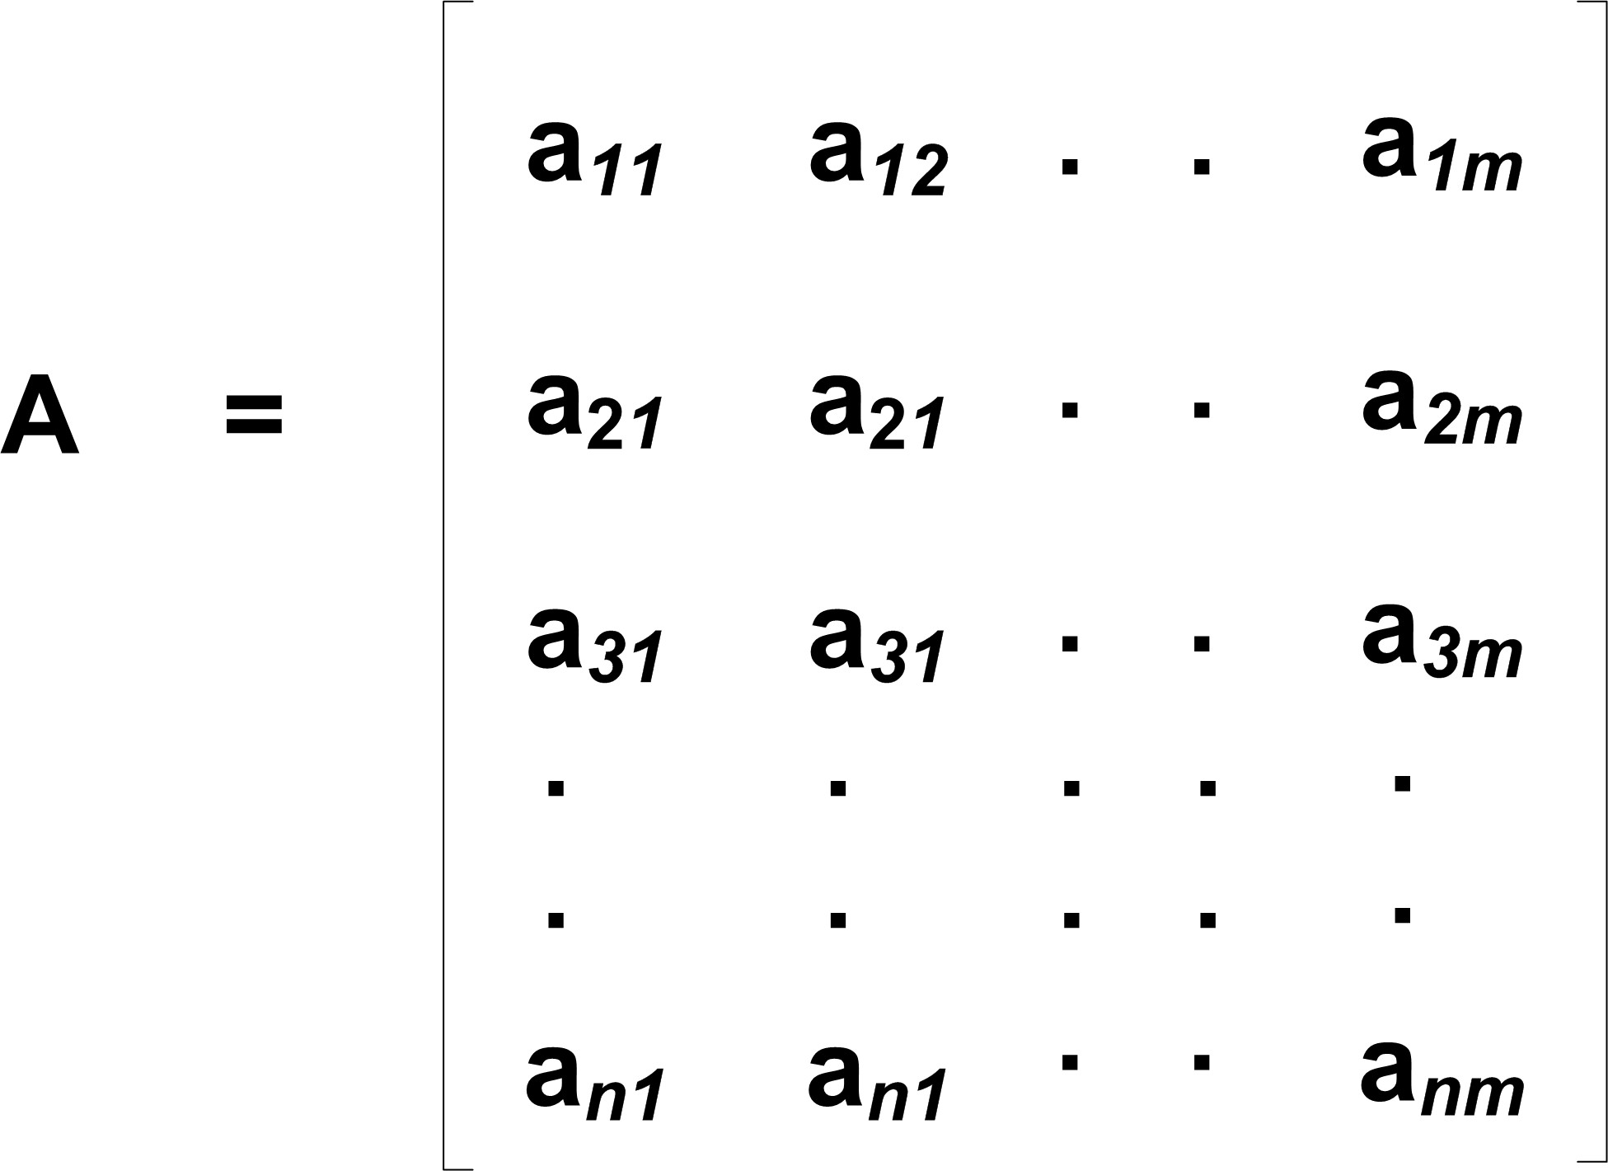
Matrix Structure

Slide 17
Operations
Matrices are used extensively in cryptography due to their ease of:
Storage
Calculation
We will be looking at the following matrix operations:
Addition/Subtraction Determinant
Inverse

Slide 18
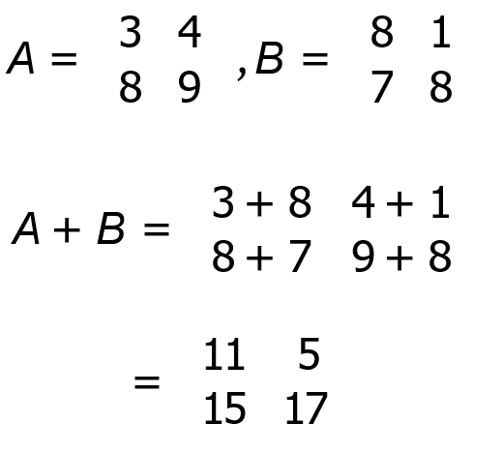
Overview
Given 2 matrices
The same rules apply for subtracting matrices

Slide 19
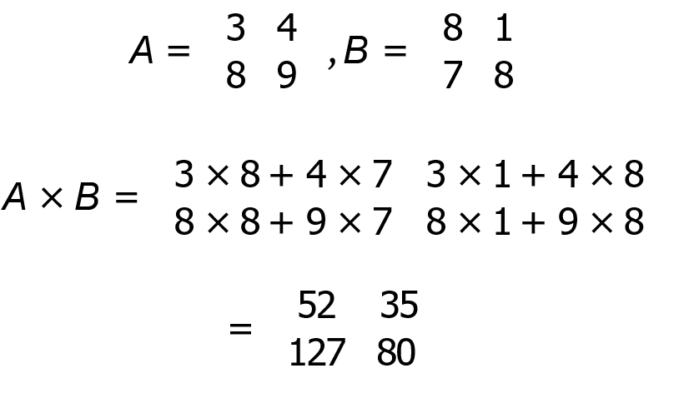
Overview
Given 2 matrices

Slide 20
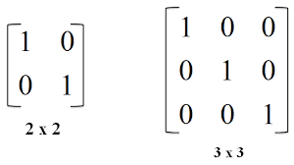
Identity matrix
Referred to as the “1” for matrices in multiplication/divisions
When used in multiplication, it does not change the values/positions of the original matrix
Examples of an identity matrix are:

Slide 21

Inverse overview
While matrix addition/subtraction are pretty straightforward, it is not that straightforward when it comes to division
We can’t use the same approach as we did with multiplication for division either
To find the inverse we follow a few rules:
1. The matrix must be non-singular 2. The determinant must not equal to 0

Slide 22
Determinant
Applies to square matrices
Matrices with the same number of rows and columns (e.g., 2 × 2)
Used to determine if a given matrix is invertible
A matrix is invertible if its determinant is non-zero

Slide 23


Calculating a determinant
Example with matrix A:

Slide 24
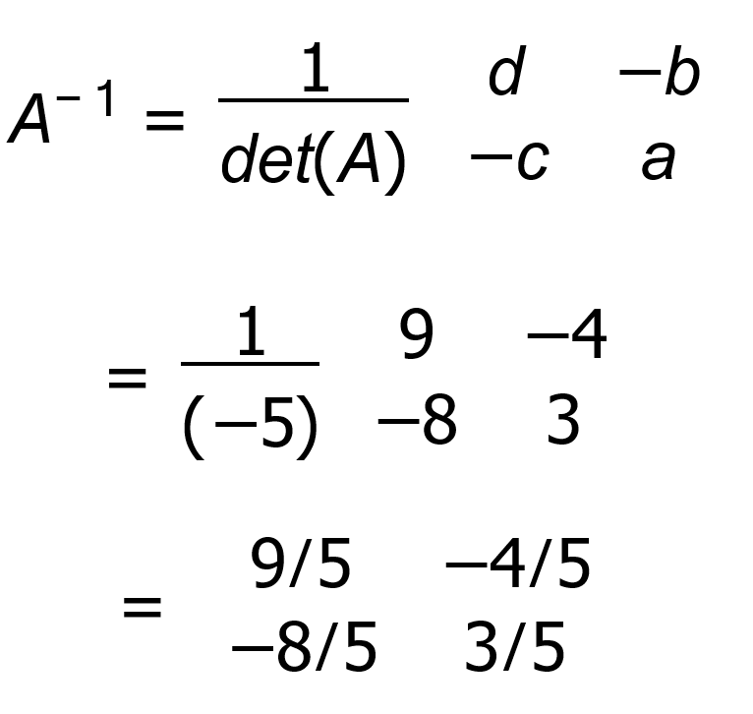
Getting the inverse of A
The inverse in then calculated by:

Slide 25
Recap
Looked at the mathematical foundations behind cryptography
Basics of division, multiplication and remainder
Matrices and their basic operations
Next week: Introduction to cryptography part 2

Slide 26
PSS
Using the article by CE Shannon and a start, write a short report on entropy and how it is used along with a critical evaluation
Other references can be used
Upload to Moodle by next Thursday

Slide 27
Questions?

